Slide 1
Machine Learning Models that Remember Too Much
Proceedings of the 2017 ACM SIGSAC Conference on Computer and
Communications Security. ACM, 2017

Slide 2
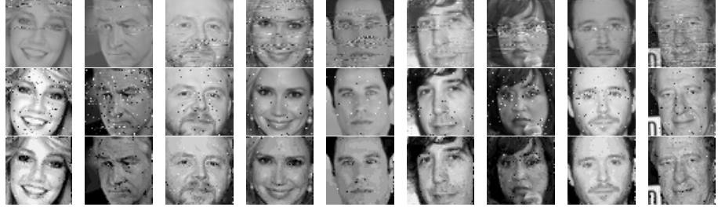
Problems & Solutions
Problem: How can an adversarial ML provider can extract sensitive training data, even in a secure platform?
Solutions: 4 new attacks
(LSB/Correlated Value/Sign Encoding, Capacity Abuse Attack)
Test Results: Successfully leaked a subset of training data
ex) Images used in image classification problems
(Quantitative results will be described in the latter slides)

Slide 3
Contributions of the Paper
Predicts minor modification on training algorithms can:
Maintain the model quality by the standard ML metrics. (cf. accuracy)
Leak detailed information about their training datasets.
(which the data holders may not want to)
Gives malicious models hiding training data in their parameters.
Recoverable either from parameter inspection or by queries.
Claims 3rd-party code to train models on sensitive data is risky.
Even in the secure platforms!

Slide 4
Paper Meanings
The paper identified the new series of attack scenarios to steal sensitive training data, even in strong defensive assumptions.
No access of ML provider to training procedure of data holders
From the general structures and the properties of the ML algorithms
The paper identified new attacks applicable for the scenarios.
The paper verified the attacks are successful in the known classification problems.

Slide 5
Situations of Machine Learning Use
Non-experts just use models ‘as-is’ from providers.
They usually do not (or cannot) check whether the models are malicious!
What if models do secondary malicious jobs, silently…?
ML models have huge memorization capability.
Especially ANNs
Models can encode more data, while maintaining high accuracy on its primary task.
What if models remember too much data that should not be leaked…?

Slide 6
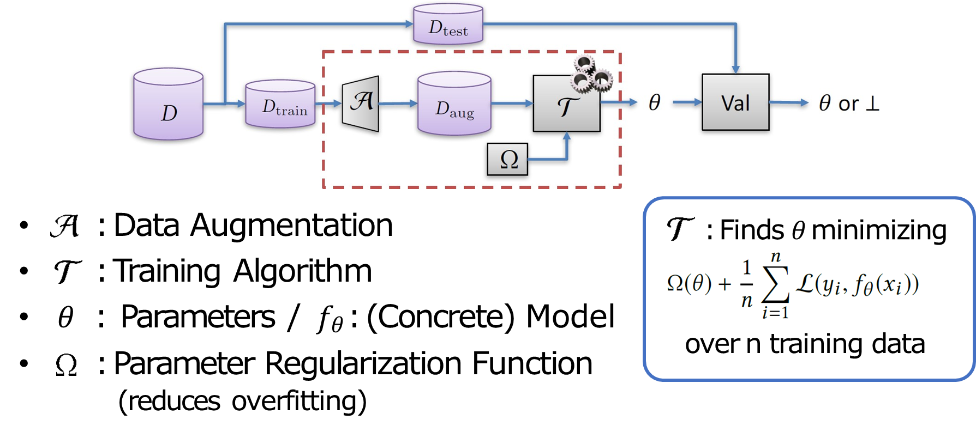
ML Pipeline (for supervised learning)

Slide 7
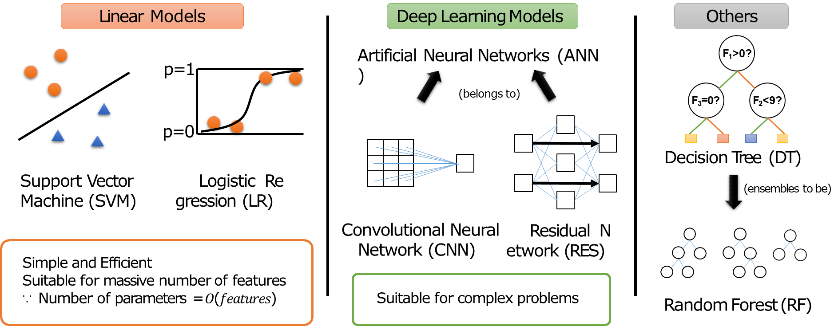
ML Models

Slide 8

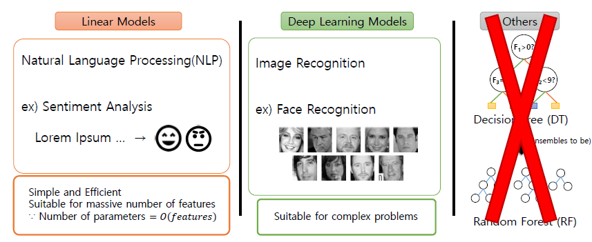
ML Models

Slide 9
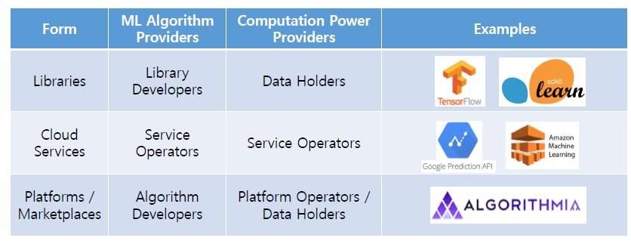
ML (Algorithm) Providers
Entities that provide ML training code to data holders

Slide 10
Efforts for Trustworthy ML platform
CQSTR (Zhai et al. In SoCC, 2016)
Cloud service with isolated execution environments, connecting between data providers and model providers
VC3 (Schuster et al. In S&P, 2015)
Cloud environment with trusted hardwares like SGX
Cryptographic Multi-party Computation
ML Classification over Encrypted Data (Bost et al. In NDSS, 2015)

Slide 11
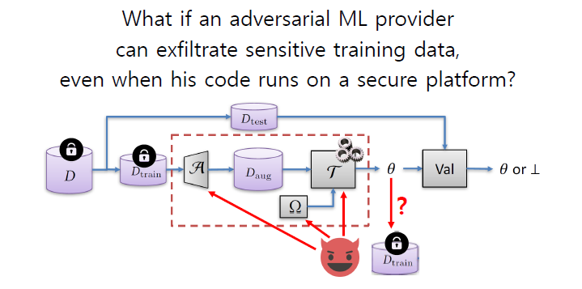
Attack Motivation

Slide 12



Attack Model
Data Holder
Wants to keep the dataset private.
Utilizes ML algorithms to analyze the dataset.
Adversary
Controls ML algorithms as a ML provider. ( )
Accesses the training results, either 𝜃(White Box) or 𝑓_{𝜃}(Black Box).
Reconstructs information for 𝐷_{𝑡𝑟𝑎𝑖𝑛} (while negligibly dropping the performance).
Note: Classifiers like SVM actually stores some training data, but the adversary wants more!

Slide 13
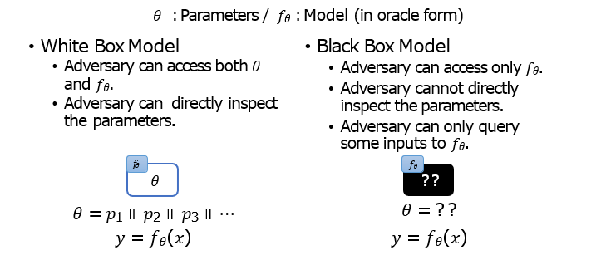
Attack Model: White Box vs. Black Box

Slide 14
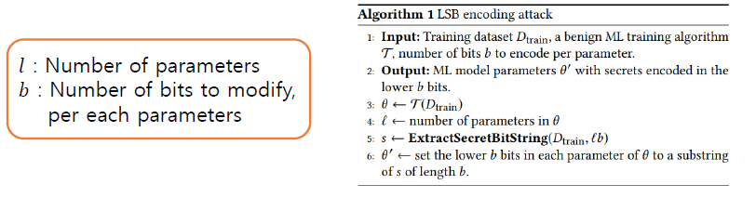
LSB Encoding Attack
Mount the training data directly in the least significant bits(LSB) of the parameters, after the training is complete.
Total information encodable: 𝑙𝑏 bits (No decoding failure)
Uses AES-CBC mode encryption in the experiment

Slide 15
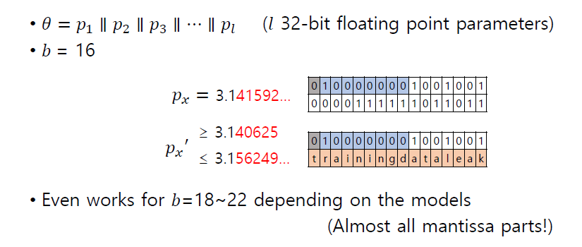
LSB Encoding Attack: Example

Slide 16
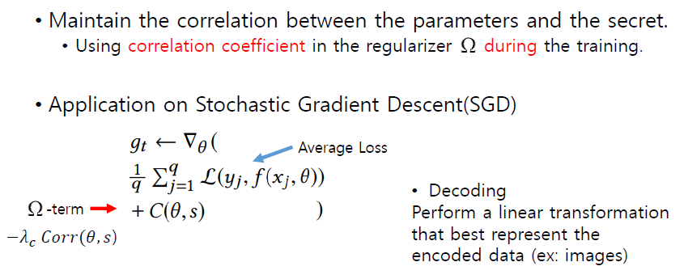
Correlated Value Encoding Attack

Slide 17
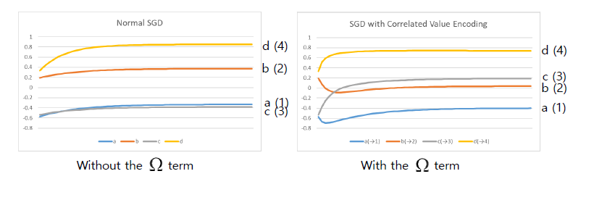
Correlated Value Encoding: Example
Simple example of a model with 4 variables (a,b,c,d)
Let the attack correlates (a,b,c,d) to secret (1,2,3,4).

Slide 18

Sign Encoding Attack
Hide the secret in the parameter signs during the training.
Total information encodable: 𝑙 bits (Number of parameters)
Add the penalty term in the regularizer similarly.
Penalty Term: Proportional to the sum of the parameters having the wrong sign against the secret bits to hide.

Slide 19


Capacity Abuse Attack
ML models can fit more data aside of the training data.
Let the model classify some adversary-given auxiliary data into classes indicating some secrets.
The adversary may query the data to the result model.
Attack on the augmentation algorithm
Training pipeline is exactly the same.
Total information extractable

Slide 20
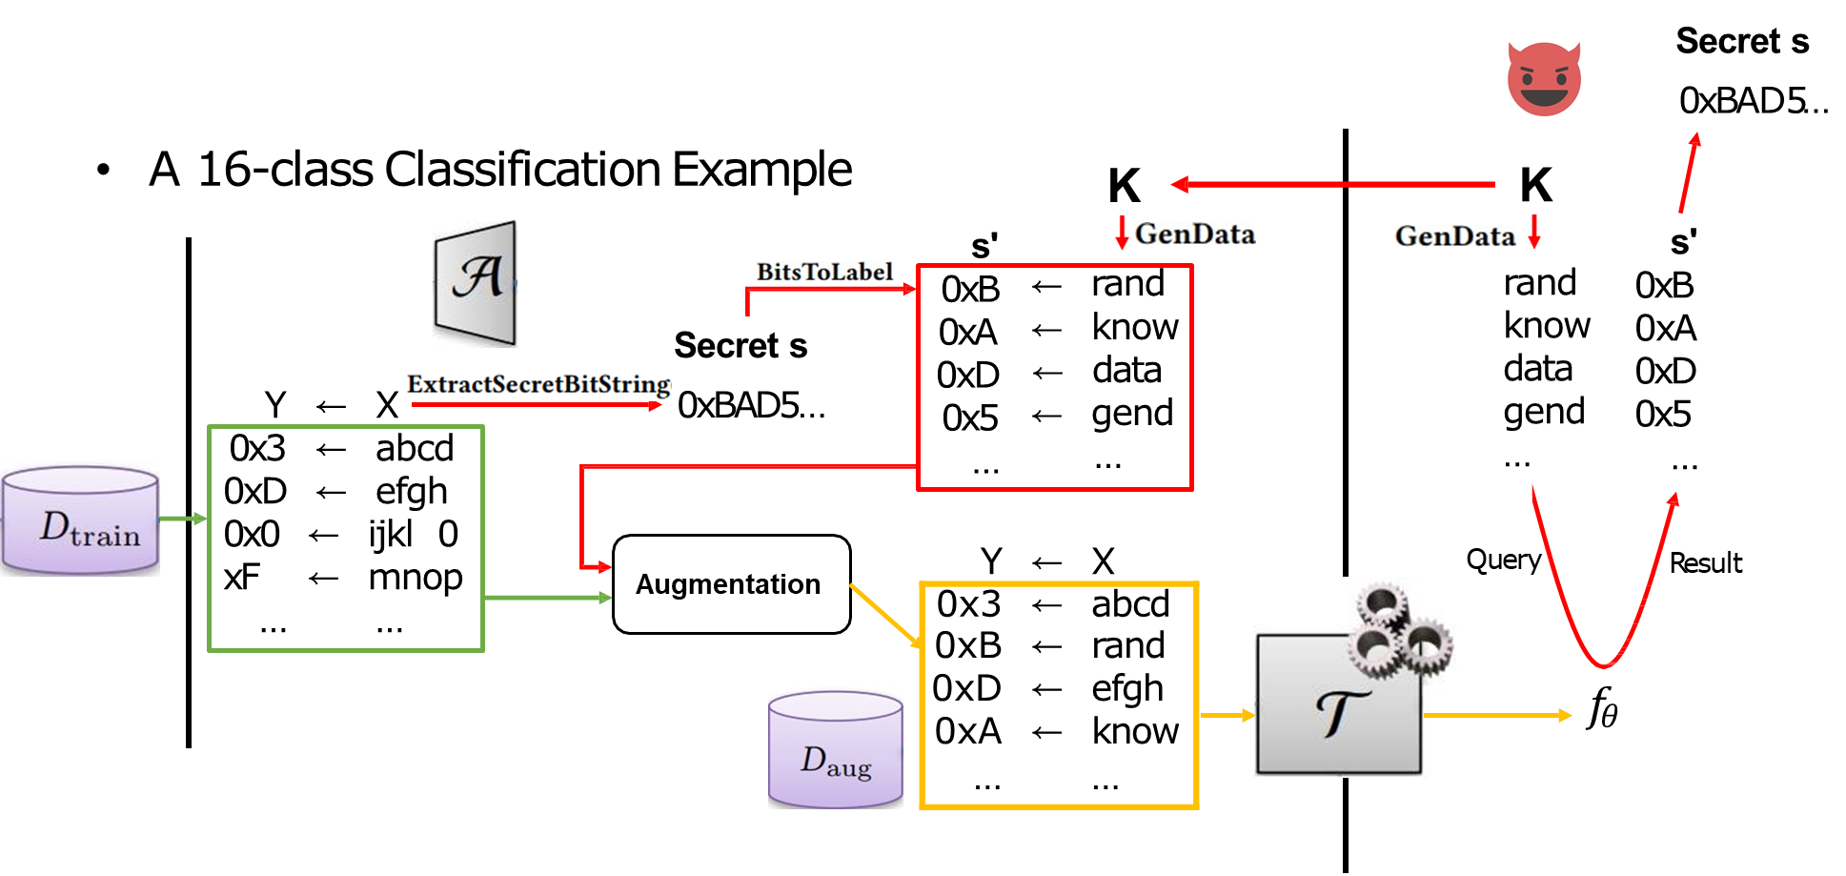
Capacity Abuse Attack: Example

Slide 21

Capacity Abuse Attack
Goal 1: High test accuracy (to make the model acceptable)
Goal 2: High training accuracy on synthetic data (to make the attack successful)
Why does it work? Are the 2 goals in conflict?
The authors say: No.
Vast Memorization Capacity
For linear models on high-dimensional sparse data: Still can find hyperplanes.

Slide 22
Experiment Descriptions
Experiment Steps
Train benign models as the baseline.
Train and evaluate malicious models, for each attack methods.
Evaluation Metrics (Under different attacks and hyperparameters)
Accuracy Drop
Decoded Secret Quality
Images: MAPE index
Texts: Precision, Recall, Cosine Similarity in Feature Vectors

Slide 23
Computational Specs
CPU: 2 CPUs
Intel i7-5960X CPUs, 8-core
RAM: 64 GB
GPU: 3 GPUs
Nvidia TITAN X (Pascal) GPUs
12 GB VRAM each
Python 2.7

Slide 24
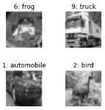
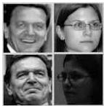

Tasks: Image Classification
For Neural Networks
CIFAR10: Object Classification
10 categories, 60,000 images(balanced)
32*32 images, 5:1 train-test split
Labeled Faces in the Wild(LFW): Gender Classification
2 categories, 13,233 images
67*42 rescaled images, 3:1 train-test split
FaceScrub: Face Recognition / Gender Classification
530 / 2 categories, 76,541 images
50*50 rescaled images, 3:1 train-test split
All images were converted to grayscale.

Slide 25
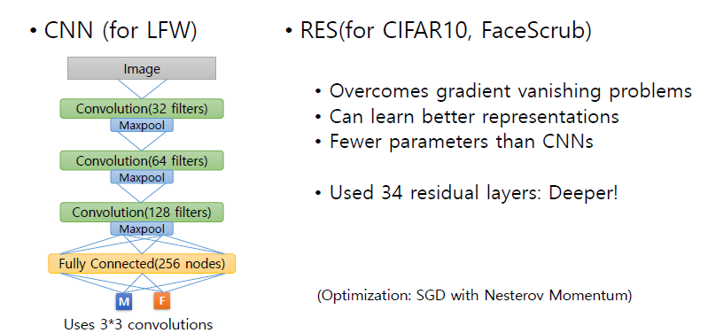
Neural Network Structures

Slide 26
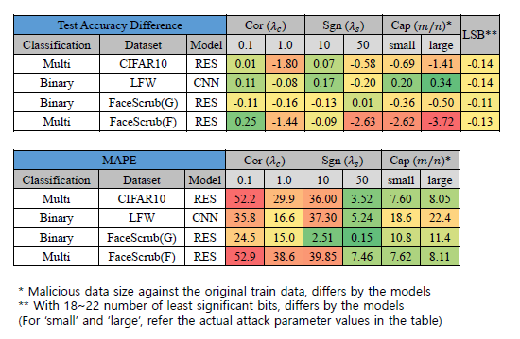
Results: Image Classification

Slide 27
Results: Image Classification
Accuracy drops are insignificant, except some multi-class tasks.
Errors are smaller for binary tasks than for multi-class tasks.
Except Capacity Abuse Attack
Capacity abuse is insufficient for breaching large data. (Still, recovering single data can be serious enough.)

Slide 28
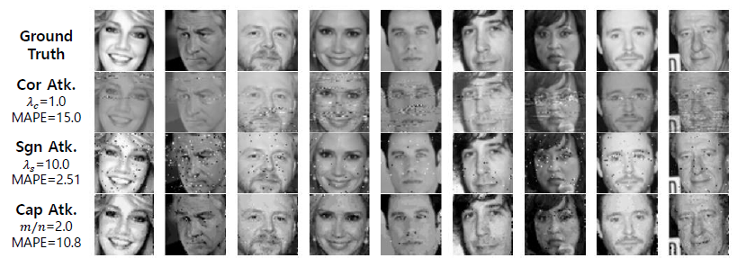
Results: Image Classification
[Fig. 3] Actual attacks from FaceScrub gender classification tasks

Slide 29
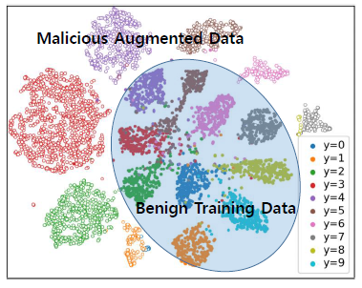
Results: Visualizing Features Learned
[Fig. 5] t-SNE mapping of final layer training outputs in CIFAR10 Capacity Abuse Attack
Classes are almost linearly separable.
This shows the model has learned both its primary task and the malicious task well.

Slide 30
Tasks: NLP
For Linear Models
20 Newsgroups: News Document Classification
20 categories, 20,000 documents
3:1 train-test split
IMDB Movie Reviews: Review Sentiment Classification
2 categories(Positive/Negative), 50,000 reviews
1:1 train-test split
Capacity Abuse attack: auxiliary vocabulary set is also tested.
Assuming the attacker does not know the input vocabulary set

Slide 31
Linear Model Configurations
Bag-of-Word (BoW) feature extraction
Counts numbers of the each words in the corpus.
Converts the word counts into vectors.
Assumes that similar texts have similar vocabulary distributions.
Vectors are fed to SVM and LF models.
20 Newsgroups: trained 20 binary classifiers for each classes
(Optimization: AdaGrad, SGD with adaptive learning rate)

Slide 32
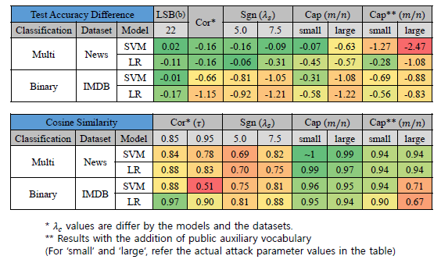
Results: Text Classification

Slide 33

Results: Text Classification
In Correlated Value Encoding, 𝜏 indicates the threshold for token accepts.
One bit decoding error produces a completely different token.
Better error-correcting decoding methods are required.
Authors claim that “decoding produces high-quality texts for both SVM and LR models” using public auxiliary vocabularies in the News task.

Slide 34
Mitigating LSB Attacks
Data holders can take the same assumption:
LSB bits exert little effect on the model performance.
Data holders can randomize LSB bits of the parameters.

Slide 35
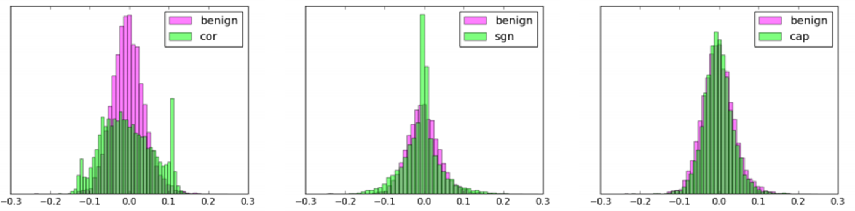
Parameter Distribution
[Left] Parameters in Correl. Value Encoding are widely distributed. [Center] Parameters in Sign Encoding are centered at zero. [Right] Capacity Abuse do not expose distribution differences.
One may need background knowledge on benign distributions to detect the attacks.

Slide 36
Pros
Logical assumption and attack derivation, in general
Tested attacks in controlled experiments and systematically analyzed them
Proposed a strong black-box attack relying on overfittings occurring in the training procedure
Requires no model parameter inspections
Not detectable through parameter distribution

Slide 37
Cons
More classes of ML models and problem classes should have been tested whether this kind of attack is possible.
Models: Decision Trees, Ensemble Models(Random Forest), …
Problem Classes: Speech Recognition, Malware Detection, Prediction problems in the real enterprise area, …
An unmentioned countermeasure on Capacity Abuse Attack:
Data holders can make model oracles producing ensembled results from 3+ algorithms written by independent ML providers.

Slide 38
Future Work Suggestions
Application of the attack to unmentioned/ensembled Models
Accuracy drop measurement on cross-validation
Malicious ML Algorithm detection, by analysis of the codes

Slide 39
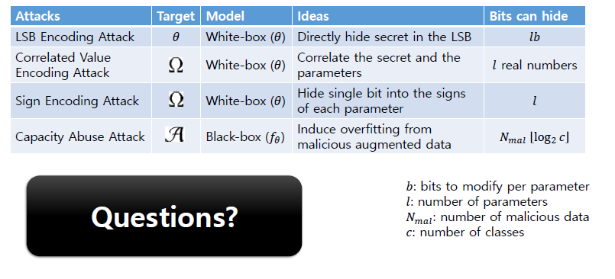
Summary

Slide 40
Questions

